Slide 1
Capstone 1
How to Reduce Insurance Payment
Ayse ‘Ashlie’ Koksoy

Slide 2
Insurance payments reduce our income by 10-15%. How can one reduce their insurance payment; by quitting smoking, losing weight or moving to another city?

Slide 3
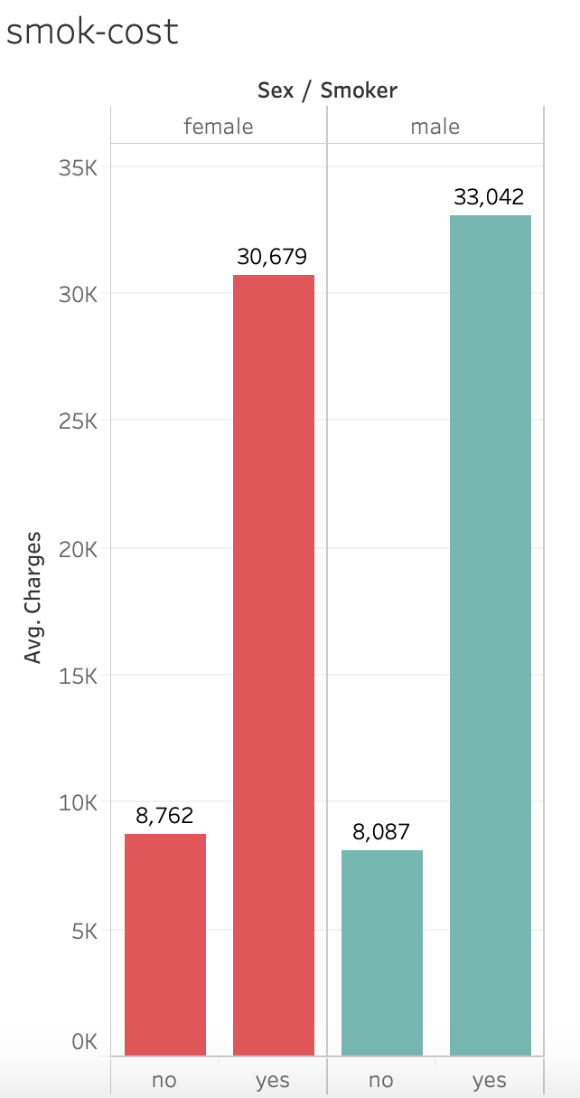
The most important factor in determining insurance costs is the Smoking status which increases the cost by 4X
Varia
Variables Tested:
Age
Sex
BMI
Children
Smoker
Region

Slide 4
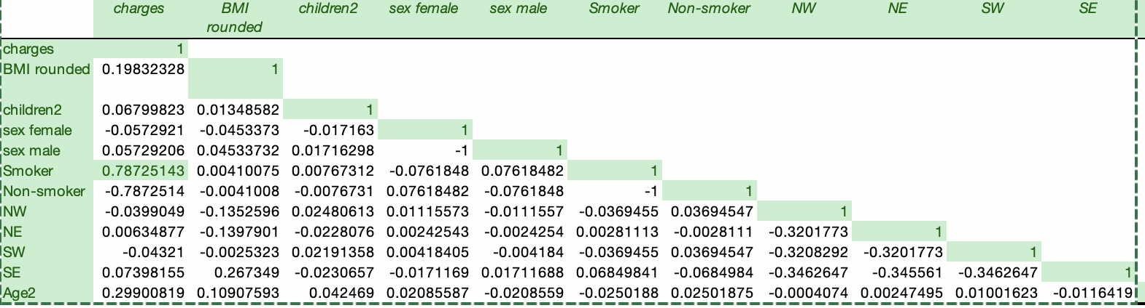
Smoking is strongly correlated with higher insurance payments

Slide 5
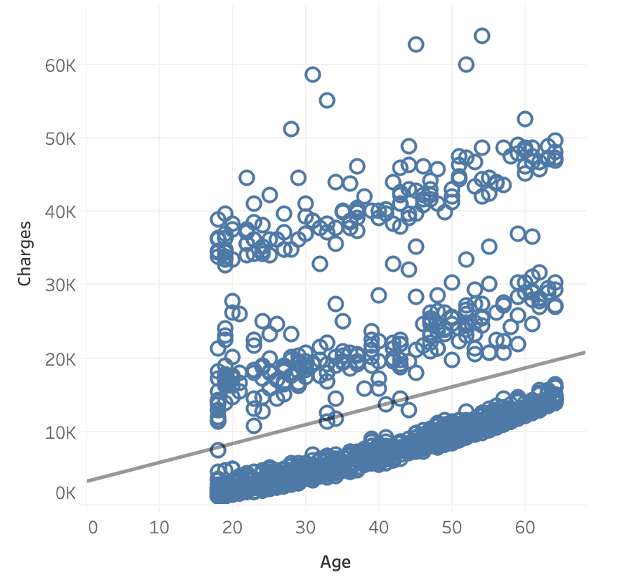
Age is positively correlated with increased payments

Slide 6
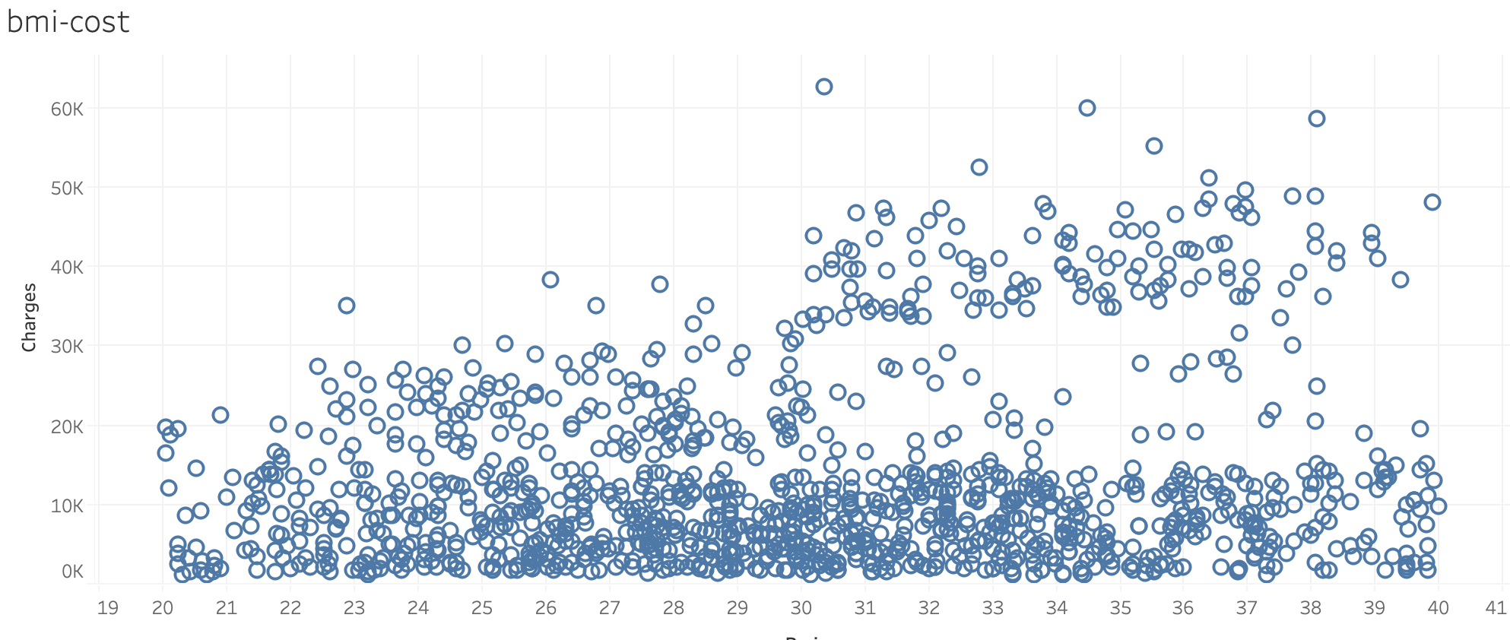
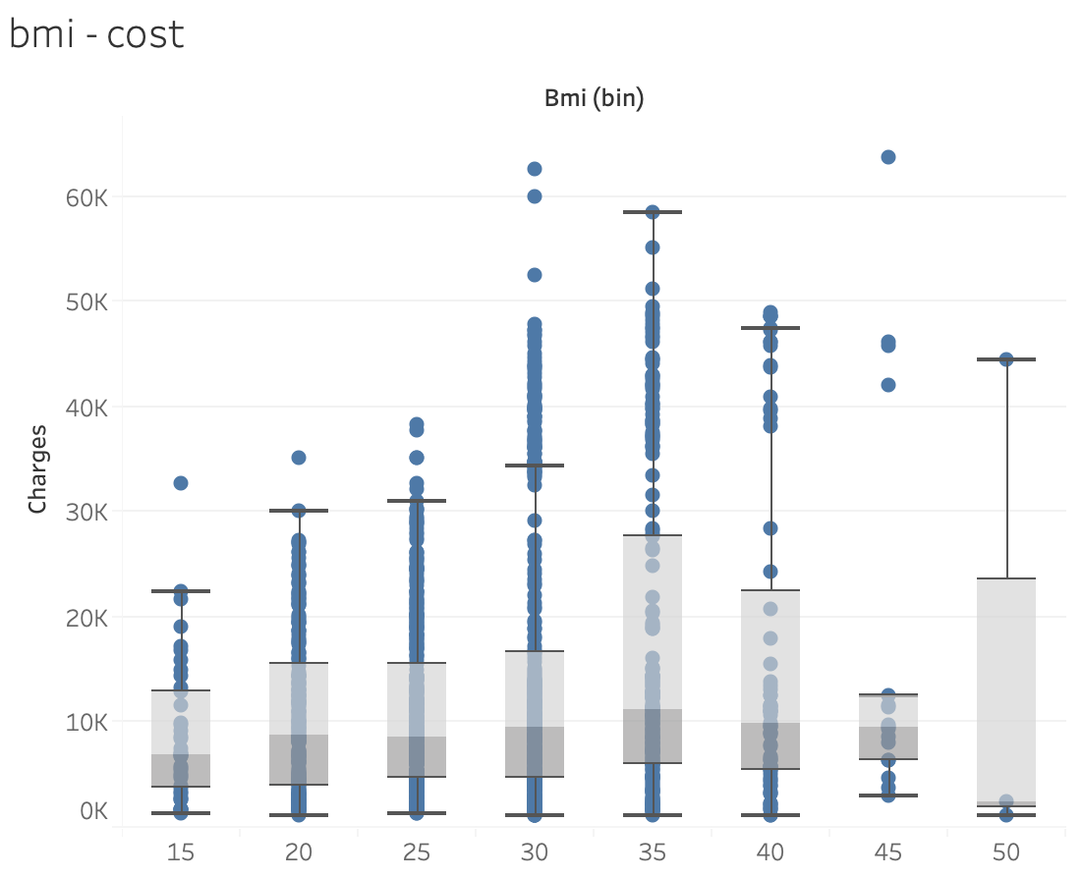
BMI and charges are weakly correlated

Slide 7
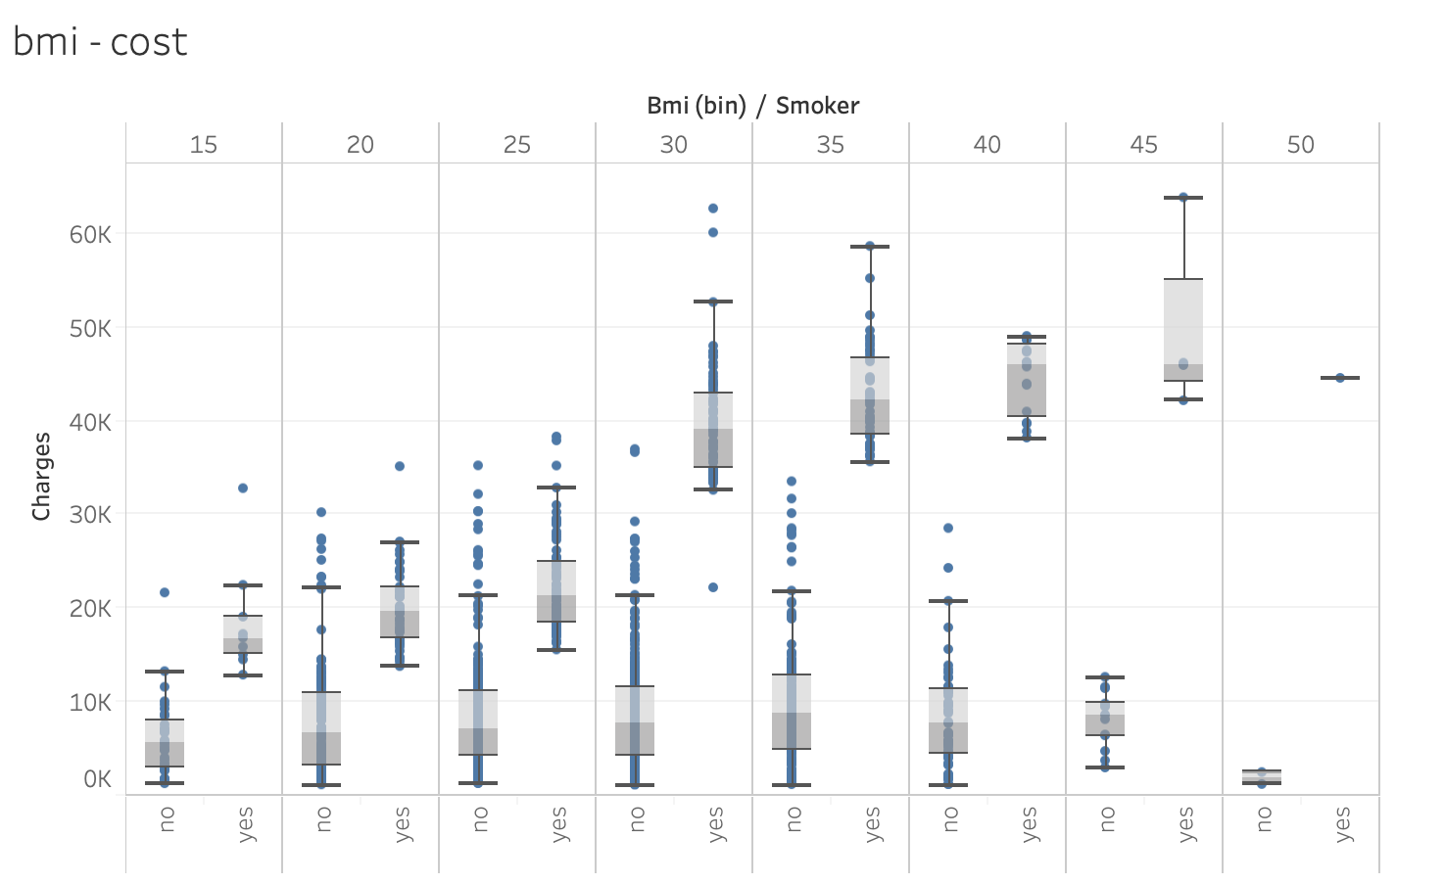
Effect of BMI is more obvious in Smokers

Slide 8
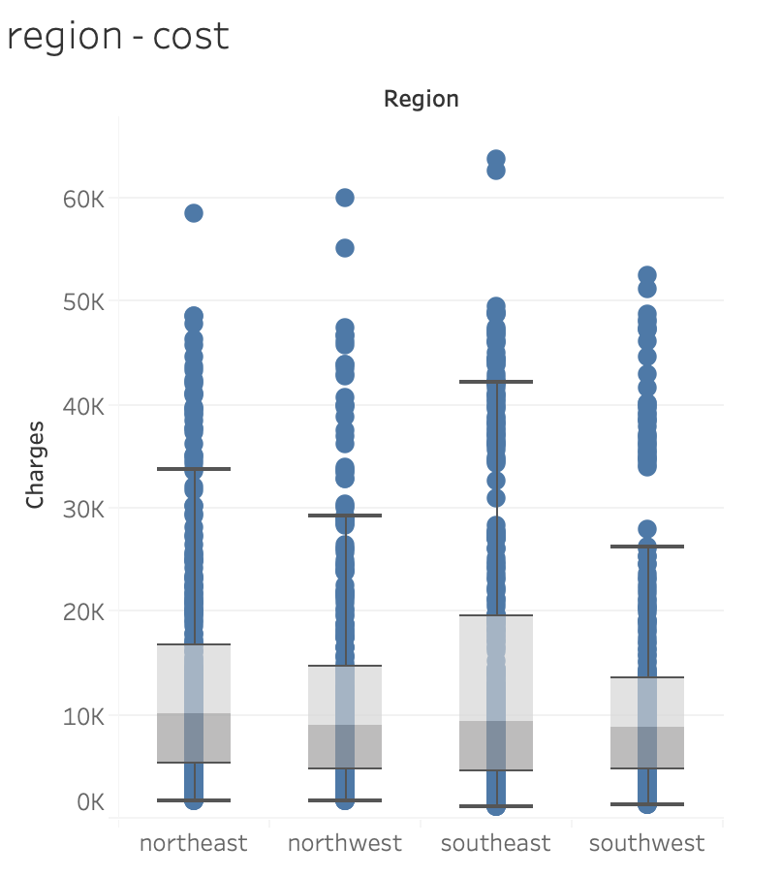
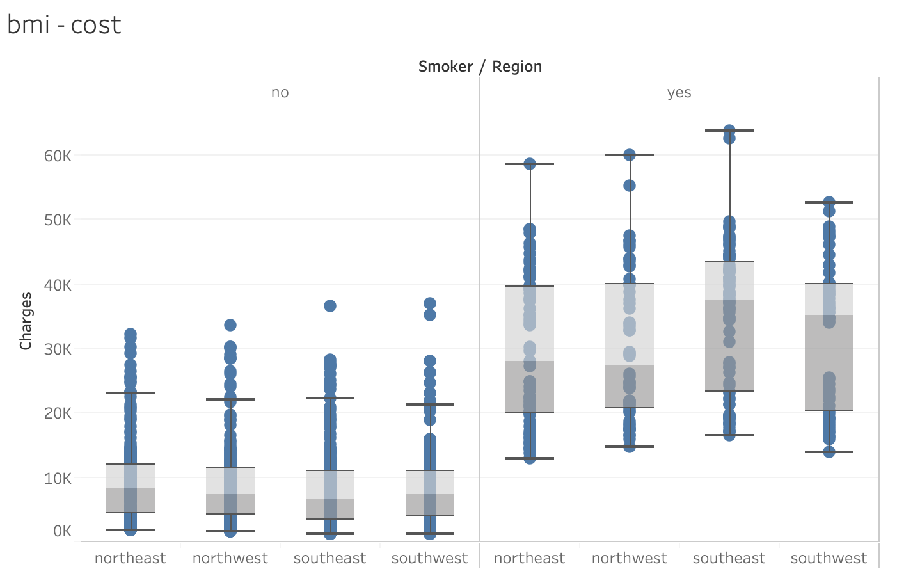
SE Region and Insurance cost correlate slightly

Slide 9
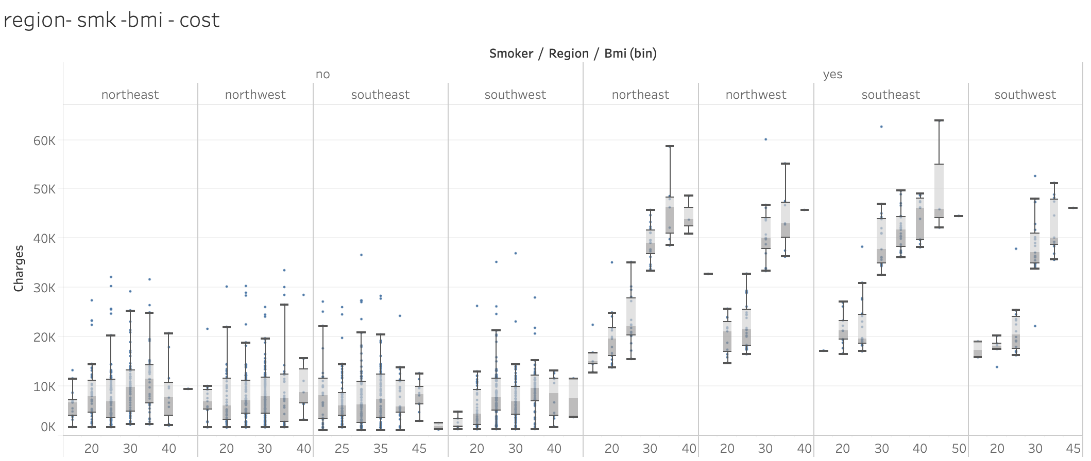
Region does not seem to contribute as much as other factors

Slide 10
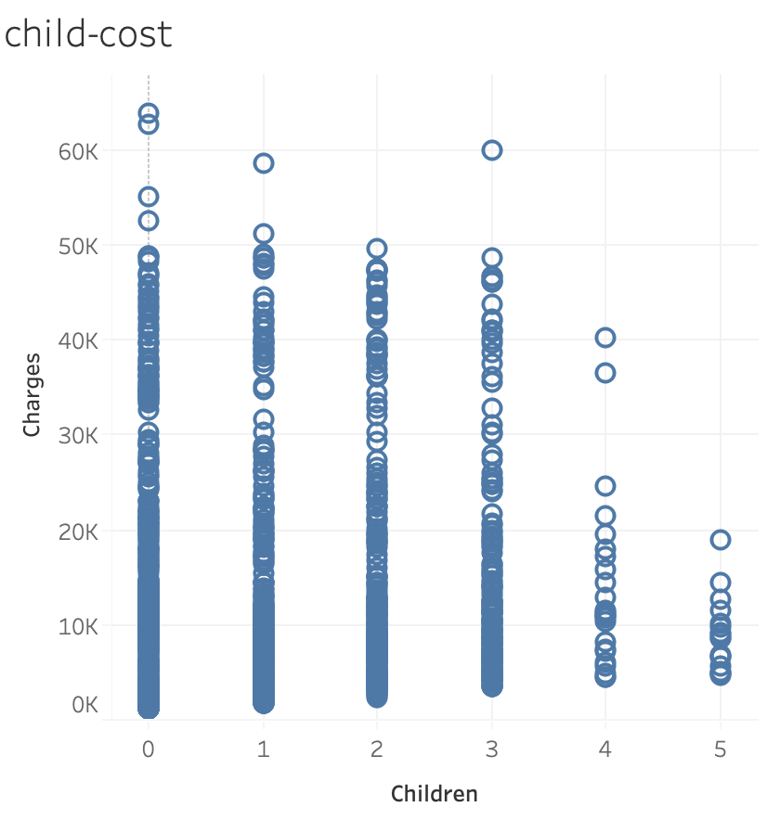
The cost seems reduced as the number of children increases

Slide 11
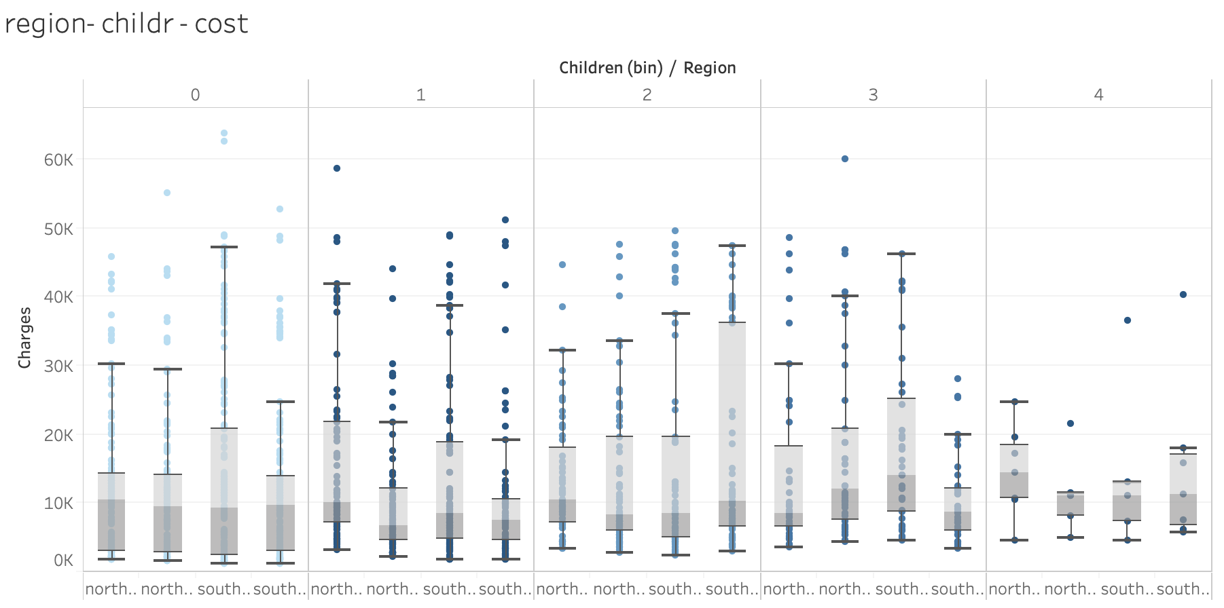
There is no correlation between regions - children and cost

Slide 12
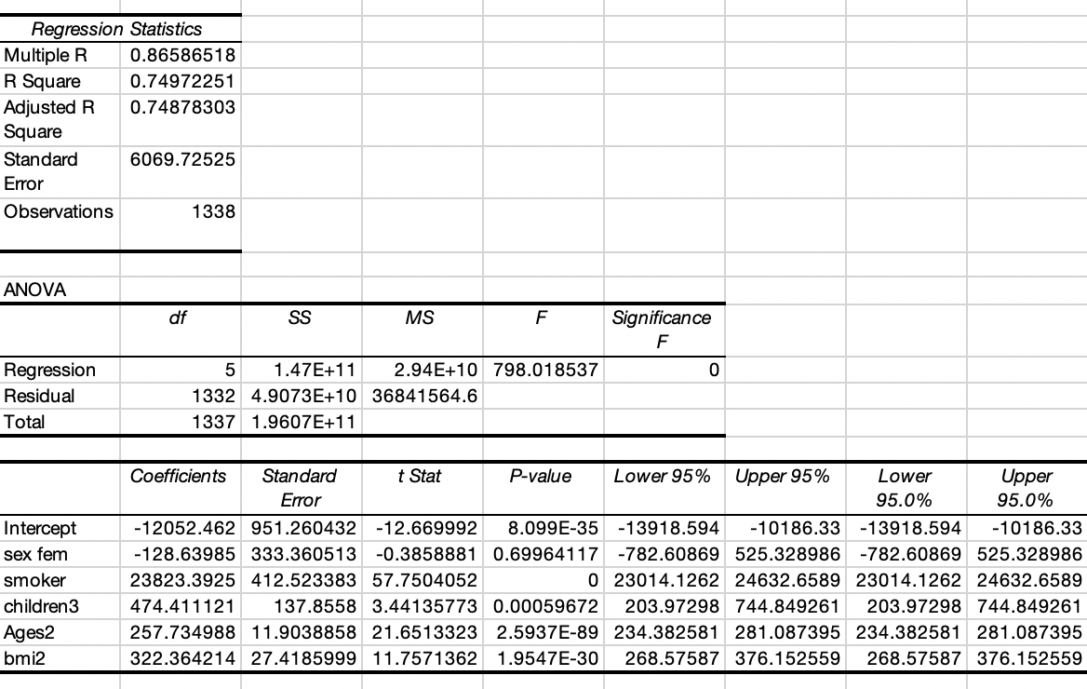
Y = -12052+322*(BMI)+474*(chil)-128*(FMal)+23823*(SMK)+257*(Age)
Regression formula is

Slide 13
The most important factor in determining insurance costs is the Smoking status which increases the cost by 4X
Varia
Variables Tested:
Age
Sex
BMI
Children
Smoker
Region

Slide 14
In summary:
Smoking is the strongest predictor of high insurance charges

